Slide 1


ECEN 404
Creating STEM Contents: Solar Power with a Tracking System
Status Update #4
Leo Predanic
George Thuita
Brandon Cenci
Sponsor: Dr. Won Jang
TA: Souryendu Das

Slide 2

Executive Summary
Problem statement:
To create the future of tomorrow, we must invest today - by getting students interested in STEM early
Our Solution:
Excite K-12 students by creating a portable solar system for demonstration purposes
Contain digestible figures & animations to describe/track system

Slide 3
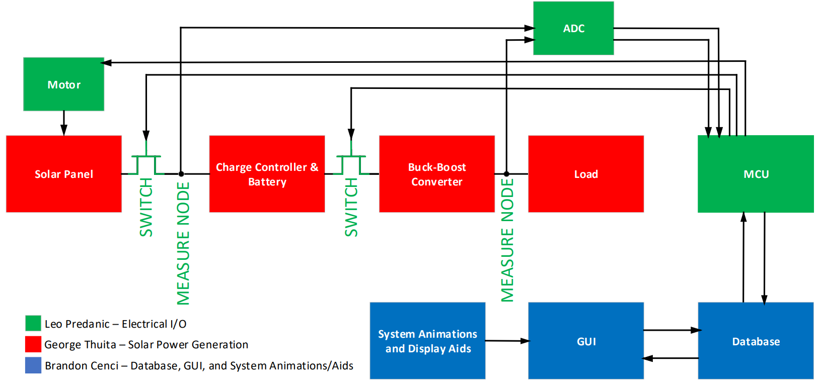
System Flow & Overview

Slide 4
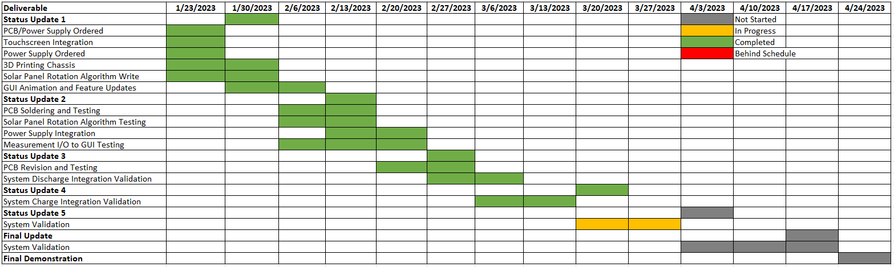
Execution

Slide 5
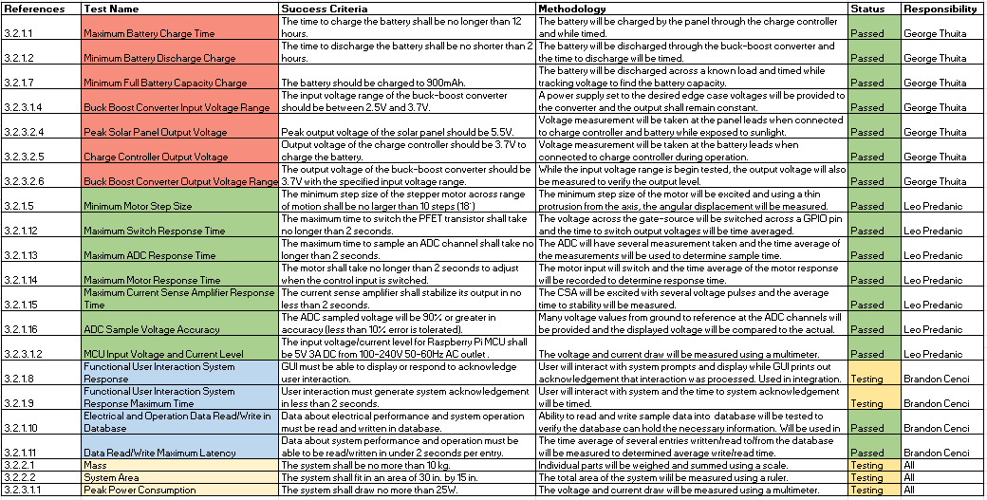
Validation

Slide 6
Integrated System George Thuita/Leo Predanic/Brandon Cenci
Accomplishments since last presentation 20 hrs each | Ongoing progress/problems and plans until next presentation
-Solar charging issues fixed -System can now solar charge (additional wired charging feature) -Validation on charge side operation -GUI updates and finalization -User control of motor and solar charging mode rotation algorithm -Validation of graphing from internal database -Addition of failsafes to ensure proper user operation | -Solar panel chassis adjustments -Preliminary complete system test -Final validation marks -Additional improvements

Slide 7
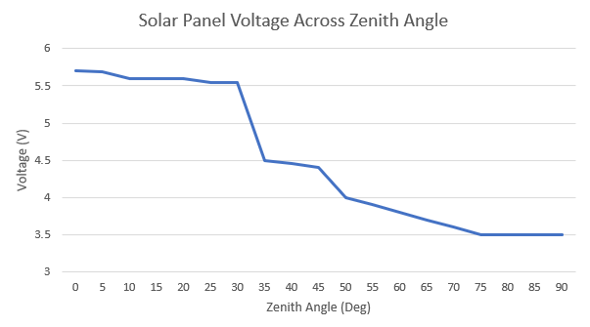
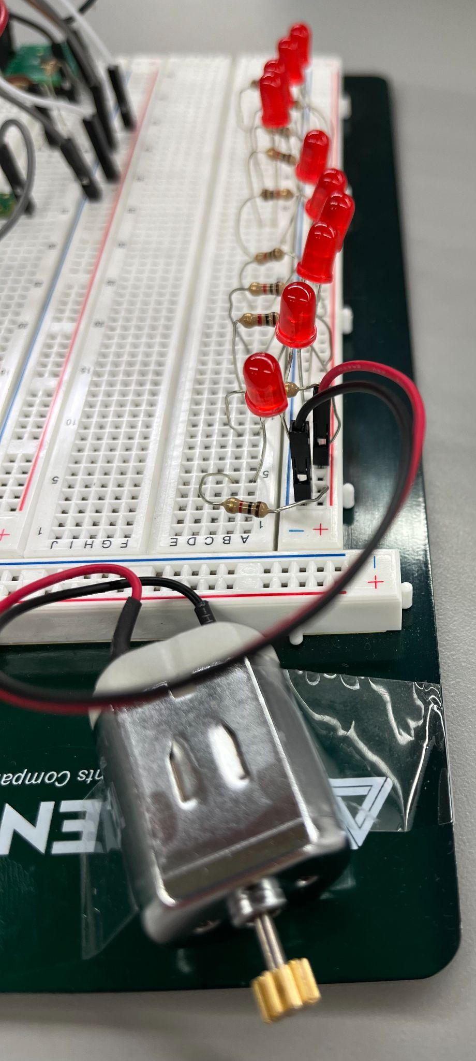
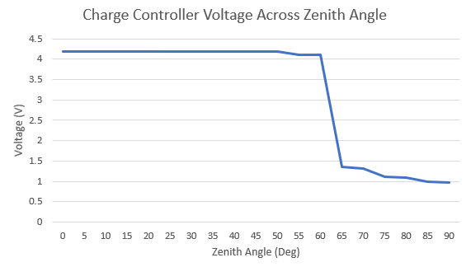
Integrated System (2) George Thuita/Leo Predanic/Brandon Cenci
Wired Charge Time: ~1 hr (Full Overcharge - 4.2V)
Solar Charge Time: 8-9 hrs (Nominal Voltage - 3.7V)
Discharge Time: ~2.5 hrs (System Load)
Capacity: ~880mAh (Full Overcharge)
Discharge Against Time Test Load
Roughly Constant Current across Battery Voltage

Slide 8
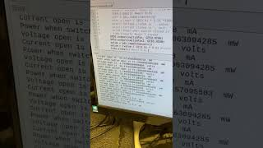
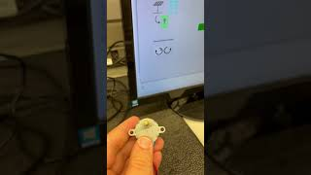
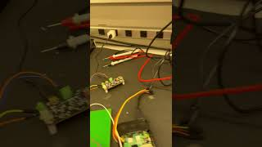
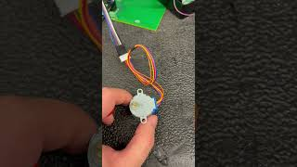
Integrated System (3) George Thuita/Leo Predanic/Brandon Cenci
Solar Panel Integration Test
Motor Manual Control
Charge Controller Integration test
Motor Timed Control

Slide 9
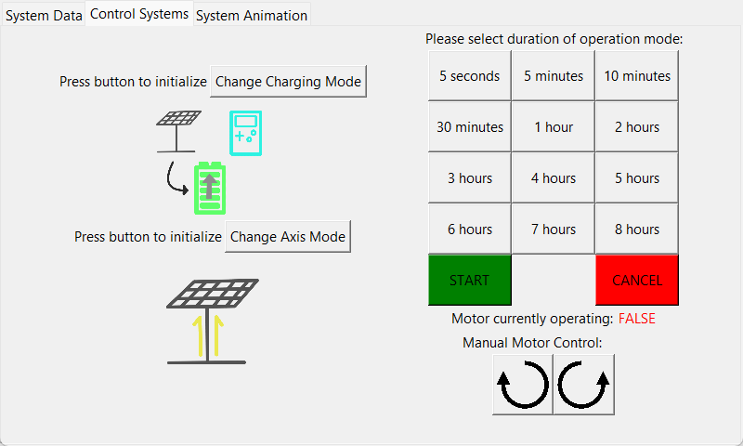
Integrated System (4) George Thuita/Leo Predanic/Brandon Cenci

Slide 10
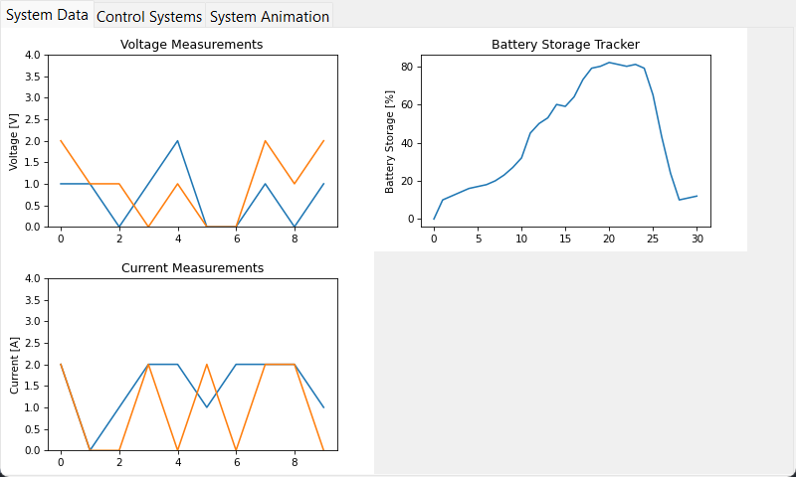
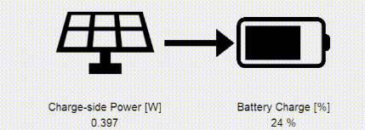
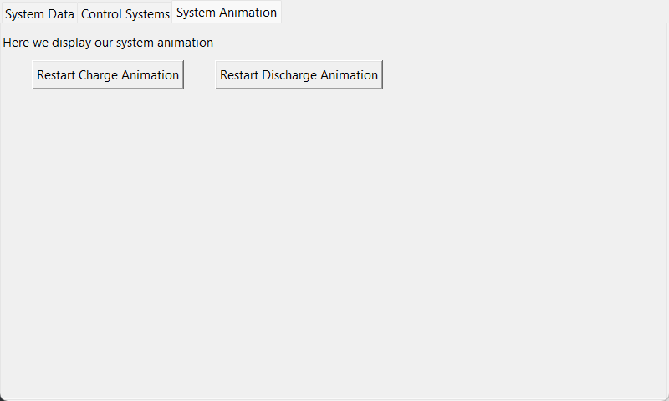
Integrated System (5) George Thuita/Leo Predanic/Brandon Cenci

Slide 11
Thank You!
Questions?

